Slide 1

DFP30243
OBJECT ORIENTED PROGRAMMING
TOPIC 3 :
CLASSES AND OBJECT

Slide 2
3.3 Construct branching statements And arrays

Slide 3
Learning Outcome
At the end of this presentation, you will be able to:
Explain selection statements in Java programs
Explain looping statements in Java programs
Build program using branching statements
Explain an array in Java program
Build reference arrays of objects in Java program
Perform Pass and return array to method
Build program using single and multidimensional array.

Slide 4
Introduction - Control Statements
Control statements are used to change the sequential flow of a program.
These set of statements are executed based on a condition.
Java supports two types of control statements:
  Branching statement
  Looping statement

Slide 5
Branching Statements
Used to evaluate expressions and direct the program execution based on the result.
The branching statements supported by Java:
    if
    switch

Slide 6
Single if.. Statement
Used to execute a set of statements when the given condition is TRUE.
Syntax
  if (<condition>)
{
<Conditional statements>;
}
Conditional statements within the block are executed when the condition in the if statement is TRUE.

Slide 7
Example
The program checks whether the given number is greater than 100.
import java.io.*;
class inputValue
{
public static void main(String args[])throws IOException
{
InputStreamReader inStream = new InputStreamReader(System.in);
BufferedReader stdin = new BufferedReader(inStream);
String str;
int num;
System.out.println("Enter the number:");
str = stdin.readLine();
num=Integer.parseInt(str);
if(num<100)
{
System.out.println("Number is less than 100");
}
}
}

Slide 8
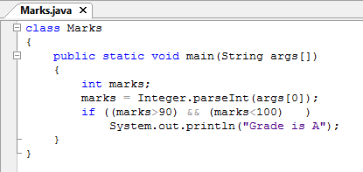
ANOTHER EXAMPLE OF IF…ELSE???
The program checks whether the marks is between 90 and 100 to print the Grade.

Slide 9
The if…else Statement
Executes the set of statements in if block, when the given condition is TRUE.
Executes the statements in the else block, when the condition is FALSE.
Syntax
    if (<condition>)
    {
    <Conditional statements1>;
    }
    else
    {
    <Conditional statements2>;
    }

Slide 10
Example
This program accepts a number, checks whether it is less than 0 and displays an appropriate message.
class Sample
{
public static void main (String args[])
{
int num;
num=Integer.parseInt(args[0]);
if (num<0)
System.out.println("Negative");
else
System.out.println("Positive");
}
}

Slide 11
Nested if Statement
The if statements written within the body of another if statement to test multiple conditions is called nested if.
Syntax
  if (<Condition 1>)
  {
  if (<Condition 2>)
  {
  <Conditional statements1>;
  }
  else
  {
  <Conditional statements2>;
  }
  }
  else
  {
  <Conditional statements3>;
  }
Inner if condition
Outer if condition

Slide 12
Example
The program accepts three integers from the user and finds the highest of the three.
class Highest {
public static void main (String args[])
{ int x; int y; int z;
x = Integer.parseInt(args[0]); y = Integer.parseInt(args[1]); z = Integer.parseInt(args[2]);
if(x>y)
{
if(x>z)
System.out.println(x + " is the highest");
else
System.out.println(z + " is the highest");
}
else
{
if (y>z)
System.out.println(y + " is the highest");
else
System.out.println(z +" is the highest");
}}}

Slide 13

Example
What is the final value of number?
int number = 2;
if (number < 0)
number = number+0;
else
{
if (number == 1)
number = number+1;
else
number = number+2;
}
The answer is 4. For the outer selection structure, the else part is executed. When executing the inner if-else part, the condition is false, thus the else part is executed.

Slide 14
Exercise
1. Accept 2 number from the user and check which number is highest number.

Slide 15
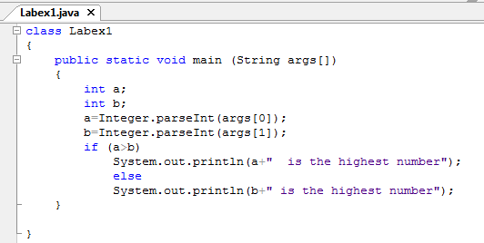
Exercise

Slide 16
Exercise
Accept a number from the user and check whether it is divisible by 5.
Hint: Use the modulus operator, %, to check the divisibility.

Slide 17
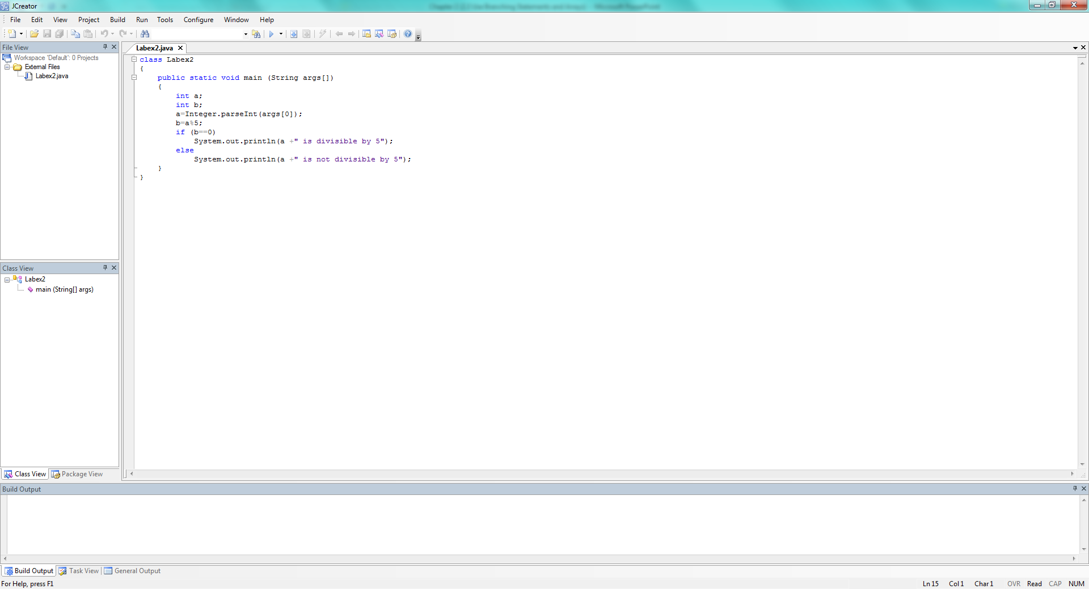
Exercise

Slide 18
Exercise
Accept a number from the user and check whether the number is an odd number or an even number.
Hint: Use the modulus operator, %, to check the divisibility.

Slide 19
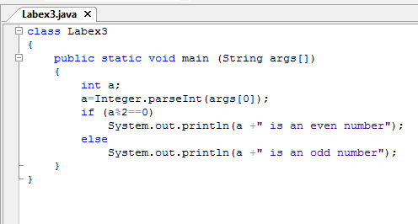
Exercise

Slide 20
The switch Statement
Is a multi-way branching/ selection statement.
Contains various case statements.
The case statements are executed based on the value of the expression.
A break statement passes the control outside switch structure.

Slide 21
The switch Statement
The variable used in a switch statement can only be integers, convertable integers (byte, short, char), strings and enums
The value for a case must be the same data type as the variable in the switch condition

Slide 22
The switch Statement
Not every case needs to contain a break. If no break appears, the flow of control will fall through to subsequent cases until a break is reached.
A switch statement can have an optional default case, which must appear at the end of the switch. The default case can be used for performing a task when none of the cases is true. break is needed in the default case.

Slide 23
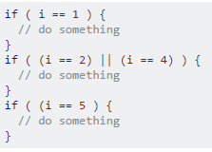
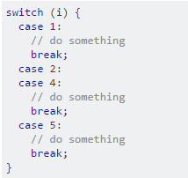
If..else vs switch..case

Slide 24
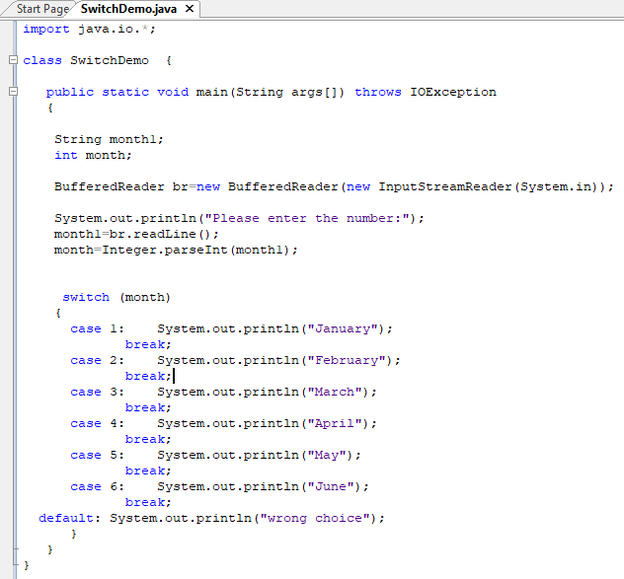
Example
The switch takes an integer value as input and displays the month based on the integer entered.

Slide 25
Full coding
import java.io.*;
class SwitchDemo {
public static void main(String args[]) throws IOException
{
String month1;
int month;
BufferedReader br=new BufferedReader(new InputStreamReader(System.in));
System.out.println("Please enter the number:");
month1=br.readLine();
month=Integer.parseInt(month1);
switch (month)
{
case 1: System.out.println("January");
break;
case 2: System.out.println("February");
break;
case 3: System.out.println("March");
break;
case 4: System.out.println("April");
break;
case 5: System.out.println("May");
break;
case 6: System.out.println("June");
break;
default: System.out.println("wrong choice");
}
}
}

Slide 26

Example
What is the final value of number?
int number=4;
switch (number)
{ case 2: number = number +10; break;
case 4: number = number +5; break;
case 6: number = number +7; break;
default: number = 0;
}
The answer is 9. A compiler will start at case labeled with 4 since the integral-value is matched with the tested expression. The accumulating statement will add up 5 to number, then ends with the keyword break.

Slide 27

Example
What is the final value of number?
int number=4;
switch (number)
{ case 2: number = number +10;
break;
case 4: number = number +5;
case 6: number = number +7;
break;
default: number = 0;
}
At case 4, number will be added by 5 which makes it 9, then the execution continues with case 6 to add 7 to number. So the final value becomes 16.
A break statement is a must if we want to execute a particular case label only.
If we do not put a break statement for each case label, the compiler will start executing at the matched case label and will continue with the remaining cases too.

Slide 28

Write a program using switch case to accept the day of the week and print the day.

Slide 29
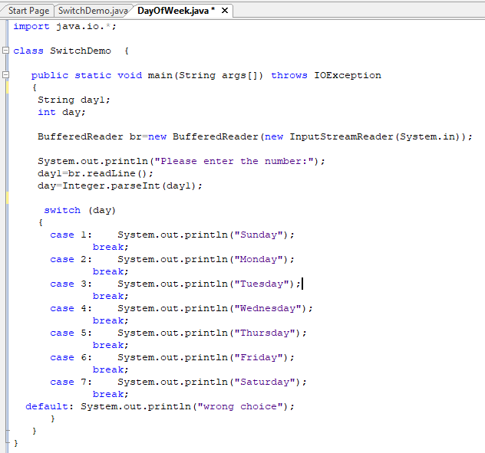

Slide 30
Full coding
import java.io.*;
class SwitchDemo {
public static void main(String args[]) throws IOException
{
String day1;
int day;
BufferedReader br=new BufferedReader(new InputStreamReader(System.in));
System.out.println("Please enter the number:");
day1=br.readLine();
day=Integer.parseInt(day1);
switch (day)
{
case 1: System.out.println("Sunday");
break;
case 2: System.out.println("Monday");
break;
case 3: System.out.println("Tuesday");
break;
case 4: System.out.println("Wednesday");
break;
case 5: System.out.println("Thursday");
break;
case 6: System.out.println("Friday");
break;
case 7: System.out.println("Saturday");
break;
default: System.out.println("wrong choice");
}
}
}

Slide 31
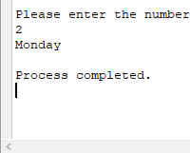

Slide 32

Write the program using switch case to checks whether the given character is a vowel.

Slide 33
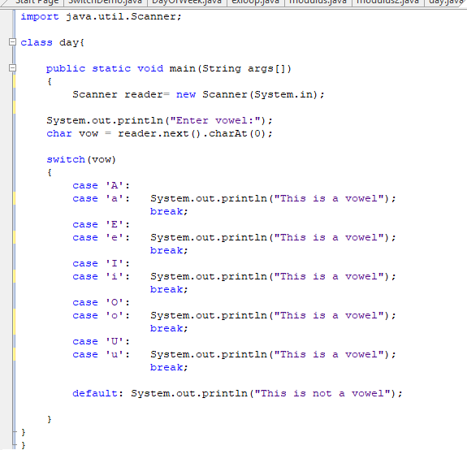


Slide 34
Full coding
import java.util.Scanner;
class day{
public static void main(String args[])
{
Scanner reader= new Scanner(System.in);
System.out.println("Enter vowel:");
char vow = reader.next().charAt(0);
switch(vow)
{
case 'A':
case 'a':
System.out.println("This is a vowel");
break;
case 'E':
case 'e':
System.out.println("This is a vowel");
break;
case 'I':
case 'i':
System.out.println("This is a vowel");
break;
case 'O':
case 'o':
System.out.println("This is a vowel");
break;
case 'U':
case 'u':
System.out.println("This is a vowel");
break;
default: System.out.println("This is not a vowel");
}
}
}

Slide 35
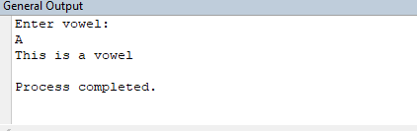

Slide 36
Revision
Write the JAVA program using switch case for the menu in ATM system as shown below:
1 | WITHDRAWAL
2 | DEPOSIT
3 | TRANSFER
4 | CHANGE PIN NUMBER
5 | PAYBILLS
6 | TOPUP

Slide 37
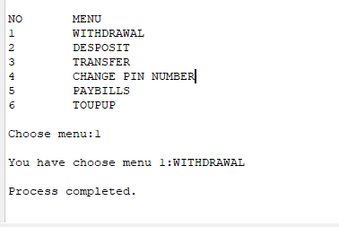
Output

Slide 38
answer
import java.util.Scanner;
class atm
{
public static void main(String args[])
{
Scanner scan=new Scanner(System.in);
System.out.println("NO\t\t MENU");
System.out.println("1\t\t WITHDRAWAL");
System.out.println("2\t\t DESPOSIT");
System.out.println("3\t\t TRANSFER");
System.out.println("4\t\t CHANGE PIN NUMBER");
System.out.println("5\t\t PAYBILLS");
System.out.println("6\t\t TOUPUP");
System.out.print("Choose menu:");
int no=scan.nextInt();
switch(no)
{
case 1: System.out.print("You have choose menu 1:WITHDRAWAL"); break;
case 2: System.out.print("You have choose menu 2:DESPOSIT");break;
case 3: System.out.print("You have choose menu 3:TRANSFER");break;
case 4: System.out.print("You have choose menu 4:CHANGE PIN NUMBER");break;
case 5: System.out.print("You have choose menu 5:PAYBILLS");break;
case 6: System.out.print("You have choose menu 6:TOUPUP");break;
default: System.out.print("Wrong menu. Please try again");break;
}
}
}

Slide 39
Looping statement

Slide 40
Looping Statements
Used to execute a set of instructions repeatedly, as long as the specific condition is satisfied.
The looping statements available in Java are:
  for
  while
  do-while

Slide 41
The for Loop
This looping statement enables you to repeat a set of instructions based on the condition.
Used when the number of loops is known before the first loop.
Syntax
for(initialisation;condition;incrementation/decrementation)
  {
  //loop statements
  }

Slide 42
The for Loop (Contd…)
The for loop has three parts:
  Initialisation: The initial value of the loop control variable is set here.
  Condition: The loop condition is specified and the loop statements are executed as long as this condition is satisfied.
  Incrementation / Decrementation: The initial value of the loop control variable is either incremented or decremented each time the loop gets executed.

Slide 43
Example
The program illustrates the working of a for loop.
class Loop
{
public static void main(String args[])
{
int num;
System.out.print("Display number 1 to 10: ");
for (num = 1; num <= 10; num++)
{
System.out.print(num);
System.out.print("\t");
}
}
}

Slide 44
The while Loop
Is a looping statement that enables you to repeat a set of instructions based on a condition.
Used when the number of loops is not known before the first loop.
Syntax
  <Initialise variable>;
  while(condition)
  {
  //loop statements
  <Increment/decrement variable>;
  }

Slide 45
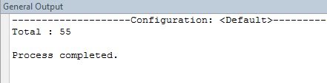
Example
Program illustrates the working of a while loop.
class WhileDemo
{
public static void main(String args[])
{
int sum=0;
int i=0;
while(i<=10)
{
sum=sum+i;
i++;
}
System.out.println("Total : " +sum);
}
}

Slide 46
The do..while Loop
The do-while loop is similar to the while loop.
The difference only in the location where the condition is checked. In do-while, condition is checked at the end of loop.
Syntax
do
{
//loop statements
} while(condition);

Slide 47
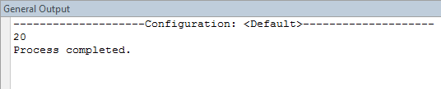
Example
Program illustrates the working of a do-while loop.
class DoWhileDemo
{
public static void main(String args[])
{
int x=20;
do
{
System.out.print(x);
x=x+1;
}while(x<15);
}
}

Slide 48
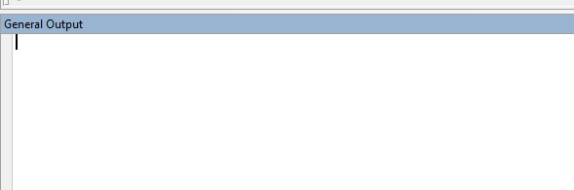
Do-while vs while loops
do-while loop.
class DoWhileDemo
{
public static void main(String args[])
{
int x=20;
do
{
System.out.print(x);
x=x+1;
}while(x<15);
}
}
while loop.
class DoWhileDemo
{
public static void main(String args[])
{
int x=20;
while(x<15)
{
System.out.print(x);
x=x+1;
}
}
}
None

Slide 49
break and continue
The break and continue statements in Java allow transfer of control from one statement to another.
The break statement causes termination of the loop and transfers the control outside the loop.
The continue statement will transfer the control to the beginning of the loop.

Slide 50
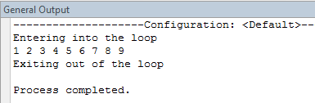
Example
Program illustrates the use of break statement.
class BreakDemo
{
public static void main(String args[])
{
int i;
System.out.println("Entering into the loop");
for(i=1;i<50;i++)
{
if(i==10)
break; // exit from for loop
System.out.print(i+" ");
}
System.out.println();
System.out.println("Exiting out of the loop");
}
}

Slide 51

Example
Program illustrates the use of continue statement. The program displays multiples of 2.
class ContinueDemo
{
public static void main(String args[])
{
for(int i=1;i<=20;i++)
{
if(i%2 != 0)
continue; //next iteration
System.out.print(i+" ");
}
}
}

Slide 52
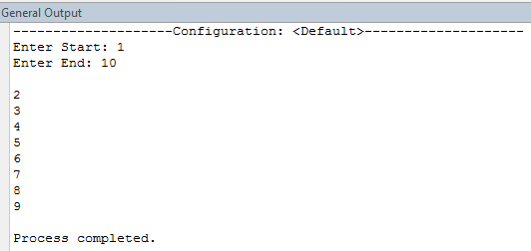
In Class Exercise

Slide 53
Answer:
import java.io.*;
import java.util.Scanner;
class minnn{
public static void main(String [ ] args)
{
Scanner input = new Scanner(System.in);
int min, max;
System.out.print("Enter Start: ");
min = input.nextInt();
System.out.print("Enter End: ");
max = input.nextInt();
System.out.println();
for(int i = ++min; i < max; i++)
System.out.println(i);
}
}

Slide 54
Summary
In this presentation, you learnt the following:
In Java, the looping statements include while, do-while and for statements.
The break statement will transfer the control to the statement outside the loop.
The continue statement will transfer the control to the beginning of the loop.

Slide 55
ARRAY

Slide 56
Array Fundamentals
An Array is a collection of similar type of variables having a common name.
Values in array are stored in memory locations.
Two types of Arrays
  One-dimensional array
  Two-dimensional array

Slide 57
One-Dimensional Array
Will have a single row and can have any number of columns.
Will have only one subscript. Subscript refers to the dimension of the array.
Example : int x[ ] =new int[4];

Slide 58
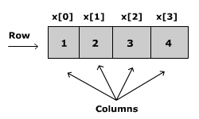

Representation of Array

Slide 59
Declaring and Initializing Arrays
You need to declare an array before using it in the program.
An array can be defined using different data types such as integer, double, float, char and so on.
However, all the values in an array must be of the same data type.

Slide 60
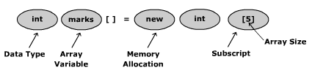
Declaring an Array
Syntax
<Data type> <Variable name> [ ] = new <Data type>[Size of the array]
Example:
int marks[ ] = new int[5];

Slide 61
Initialization of an Array
Initialisation is the process of assigning values to the array you have created.
Example
    marks[0] = 95;
    marks[1] = 85;
    marks[2] = 75;
    marks[3] = 80;
    marks[4] = 65;

Slide 62
Initialisation of an Array
Syntax :
<Variable name>[Array index] = Value;
The first element will always have the array index as 0.
Array index refers to the location of the values in an array.
For example:
marks[0]=95;
marks[1]=85;
marks[2]=75;

Slide 63
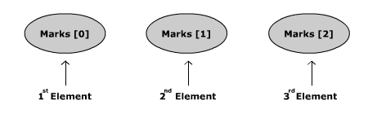

Array Elements
The representation of the array for the example in the previous slide is as follows.
Here, 0, 1 and 2 are the index of the array, marks.

Slide 64
Initialise an Array
You can also initialise the array at the time of declaration as shown in the following example:
int marks[] = {95,85,75};
When initialising an array, the values are enclosed within curly brackets { }.

Slide 65
Accessing Array Elements
Using the array index you can access the array elements.
To print the value of the second element in an array, the code will be:
System.out.println(“The second element:” + marks[1]);

Slide 66
Example:
Program illustrate how to declare an array, initialise it and access its elements.
class StudentMarks
{
public static void main(String args[])
{ int marks[]={95,85,75,80,65};
System.out.print("\n marks[0] : "+marks[0]);
System.out.print("\n marks[1] : "+marks[1]);
System.out.print("\n marks[2] : "+marks[2]);
System.out.print("\n marks[3] : "+marks[3]);
System.out.print("\n marks[4] : "+marks[4]);
}
}

Slide 67
Entering Data into an Array
When more number of values are to be stored in an array, a for loop can be used.
The sample code shows how to use a for loop in an array.
  for(int i=0;i<5;i++)
  {
  System.out.print("Enter the marks: ");
  str = stdin.readLine();
  marks[i] = Integer.parseInt(str);
  }

Slide 68
Reading Data from an Array
You can use a for loop with a single println statement to print the values from an array.
  for (int i=0;i<5;i++)
  {
  System.out.println("Marks:"+marks[i]);
  }

Slide 69
Example:
Program illustrates how to accept five marks from the user and prints the values on the screen.
import java.util.Scanner;
class oneintarray {
public static void main(String args[])
{
Scanner scan = new Scanner(System.in);
int marks[]=new int[6];
for(int i=0;i<5;i++) //Accepting the marks
{
System.out.print("Enter mark"+(i+1)+" :");
marks[i]=scan.nextInt();
}
for(int i=0;i<5;i++) //Displaying the array
{
System.out.println("Marks "+(i+1)+" :"+marks[i]);
}
}
}

Slide 70
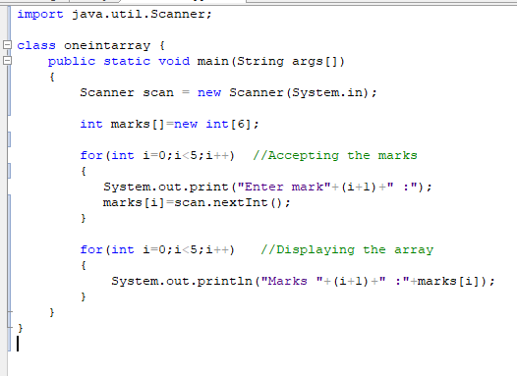

Slide 71
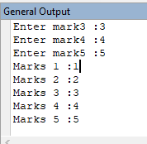

Slide 72
Two dimensional array

Slide 73
Two-Dimensional Arrays
Are arrays with more than one dimension.
Is a collection of a number of one-dimensional arrays placed one below the other.
Two-dimensional arrays represent data in terms of rows and columns. It has two subscripts.

Slide 74
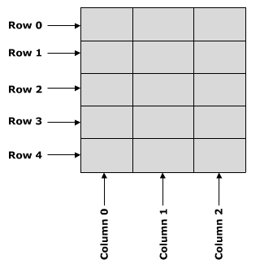
Representation – 2D Array

Slide 75
Declaring & Initialising 2D Array
Assume that there are 5 students in a class and each of them study three different subjects, for example Mathematics, Physics and Chemistry.
The marks of each student in all three subjects can be represented in a single row.

Slide 76
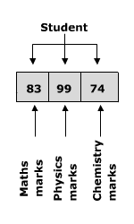
1-D Array Representation

Slide 77
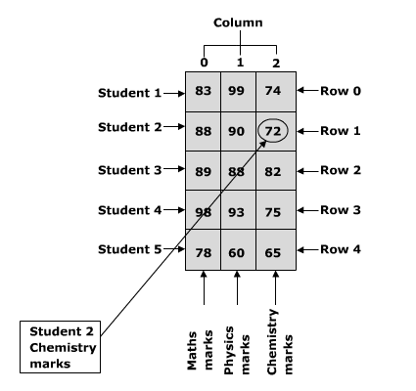
2-D Array Representation

Slide 78
Declaration of 2-D Array
Example
int marks_table[][] = new int[5][3];
Syntax
<Data type> <Variable name>[][] = new int[Row][Column];

Slide 79
Activity 3
Give the value of the following elements in the 2-D representation referring to the picture.
marks_table[0][0]
marks_table[1][1]
marks_table[3][0]
marks_table[4][2]

Slide 80
Accessing Array Elements
You can use the row and column array index to access the array elements.
For example, if you need to print the value stored in first row and second column of the array marks_table, (i.e. chemistry mark of student 2) the code will be :
Example
System.out.println(marks_table[1][2]);

Slide 81
Example:
Program will illustrate how to declare a two dimensional array, initialise it and access its elements.
class TwoDimArray {
public static void main(String args[])
{
int marks_table[ ][ ] = { {83,99,74},
{88,90,72},
{89,88,82},
{98,93,75},
{78,60,65} };
System.out.println(marks_table[1][2]);
}
}

Slide 82
Entering Data into Array
A nested for loop can be used to enter data in a 2D array
For example,
for (int x=0;x<2;x++)
{
for(int y=0;y<3;y++)
{
m = stdin.readLine();
marks_table[x][y] =
Integer.parseInt(m);
}
}

Slide 83
Reading Data from an Array
Example to read data from an array
  for(int x=0;x<2;x++)
  {
  for(int y=0;y<3;y++)
  {
  System.out.println("Marks:” +
  marks[x][y]);
  }
  }

Slide 84
Example:
Program illustrates how to accept the student marks.
import java.io.*;
class TwoDimArray2{
public static void main(String args[]) throws IOException {
BufferedReader stdin = new BufferedReader(new InputStreamReader(System.in));
String m;
int marks_table[][]=new int[2][3];
for(int x=0;x<2;x++)
{
for(int y=0;y<3;y++)
{m = stdin.readLine();
marks_table[x][y]=Integer.parseInt(m);}
}
for(int x=0;x<2;x++)
{
for(int y=0;y<3;y++)
{System.out.println("Marks:”+marks[x][y]);}
}
}}

Slide 85
Summary
In this presentation, you learnt the following
Two-dimensional arrays have two subscripts.
Two-dimensional arrays will have n rows and m columns.
The number of elements in a two-dimensional arrays is n*m.

